Slide 1
Principles of Operating Systems
Input/Output

Slide 2
I/O devices - terminology
Device (mechanical hardware)
Device controller (electrical hardware)
Device driver (software)
Notes:
Separte I/O memory space
Memory mapped i/o
Hybrid
Memory mapped takes part of memory for moving I/O around. Has nothing to do with DMA.

Slide 3

Example devices and their controllers
Monitor
Bus
Components of a simple personal computer

Slide 4
Device controllers
The Device vs. its Controller
Some duties of a device controller:
  Interface between CPU and the Device
  Start/Stop device activity
  Convert serial bit stream to a block of bytes
  Deal with errors
    Detection / Correction
  Move data to/from main memory
Some controllers may handle several (similar) devices

Slide 5
Device Driver
A device driver is a software module, that controls various I/O device through the device controller

Slide 6
Performance challenges: I/O software
How to prevent CPU throughput from being limited by I/O device speed (for slow devices)
  Why would slow devices affect the CPU?
How to prevent I/O throughput from being limited by CPU speed (for fast devices)
  Why would device throughput be limited by the CPU?
How to achieve good utilization of CPU and I/O devices
How to meet the real-time requirements of devices

Slide 7
Input/Output functions
There are three techniques for performing input/ouput:
  Programmed I/O
  Interrupt-Driven I/O
  Direct Memory Access

Slide 8
Programmed I/O
The programmed I/O, the most simple type of I/O technique for the exchanges of data or any types of communication between the processor and the external devices.
With programmed I/O, data are exchanged between the processor and the I/O module.
The processor executes a program that gives it direct control of the I/O operation, including sensing device status, sending a read or write command, and transferring the data.
When the processor issues a command to the I/O module, it must wait until the I/O operation is complete.

Slide 9
Programmed I/O
If the processor is faster than the I/O module, this is wasteful of processor time. The overall operation of the programmed I/O can be summaries as follow:
The processor is executing a program and encounters an instruction relating to I/O operation.
The processor then executes that instruction by issuing a command to the appropriate I/O module.
The I/O module will perform the requested action based on the I/O command issued by the processor (READ/WRITE) and set the appropriate bits in the I/O status register.
The processor will periodically check the status of the I/O module until it find that the operation is complete.

Slide 10
Interrupt-Driven I/O
Interrupt driven I/O is an alternative scheme dealing with I/O.
Interrupt I/O is a way of controlling input/output activity whereby a peripheral or terminal that needs to make or receive a data transfer sends a signal.
This will cause a program interrupt to be set. At a time appropriate to the priority level of the I/O interrupt. Relative to the total interrupt system, the processors enter an interrupt service routine.
The function of the routine will depend upon the system of interrupt levels and priorities that is implemented in the processor.
The interrupt technique requires more complex hardware and software, but makes far more efficient use of the computer’s time and capacities

Slide 11

Hardware support for interrupts
How interrupts happen. Connections between devices and interrupt controller actually use interrupt lines on the bus rather than dedicated wires

Slide 12
Problem with Interrupt driven I/O
Problem:
  CPU is still involved in every data transfer
  Interrupt handling overhead is high
  Overhead cost is not amortized over much data
  Overhead is too high for fast devices
    Gbps networks
    Disk drives

Slide 13
Direct Memory Access (DMA)
Data transferred from device straight to/from memory
CPU not involved
The DMA controller:
  Does the work of moving the data
  CPU sets up the DMA controller (“programs it”)
  CPU continues
  The DMA controller moves the bytes

Slide 14

Direct Memory Access (DMA)

Slide 15
Direct Memory Access (DMA)
Cycle Stealing
  DMA Controller acquires control of bus
  Transfers a single byte (or word)
  Releases the bus
  The CPU is slowed down due to bus contention
Burst Mode
  DMA Controller acquires control of bus
  Transfers all the data
  Releases the bus
  The CPU operation is temporarily suspended

Slide 16
Direct Memory Access (DMA)
Cycle Stealing
  DMA controller acquires control of bus
  Transfers a single byte (or word)
  Releases the bus
  The CPU is slowed down due to bus contention
  Responsive but not very efficient
Burst Mode
  DMA Controller acquires control of bus
  Transfers all the data
  Releases the bus
  The CPU operation is suspended
  Efficient but interrupts may not be serviced in a timely way

Slide 17
Principles of I/O software
Device Independence
  Programs can access any I/O device
    Hard Drive, CD-ROM, Floppy,...
    ... without specifying the device in advance
Uniform Naming
  Devices / Files are named with simple strings
  Names should not depend on the device
Error Handling
  ...should be as close to the hardware as possible
  … because its often device-specific

Slide 18
Principles of I/O software
Synchronous vs. Asynchronous Transfers
  Process is blocked vs. interrupt-driven or polling approaches
Buffering
  Data comes off a device
  May not know the final destination of the data
    e.g., a network packet... Where to put it???
Sharable vs. Dedicated Devices
  Disk should be sharable
  Keyboard, Screen dedicated to one process

Slide 19
Software engineering-related challenges
How to remove the complexities of I/O handling from application programs
  Solution
    standard I/O APIs (libraries and system calls)
How to support a wide range of device types on a wide range of operating systems
  Solution
    standard interfaces for device drivers (DDI)
    standard/published interfaces for access to kernel facilities (DKI)

Slide 20
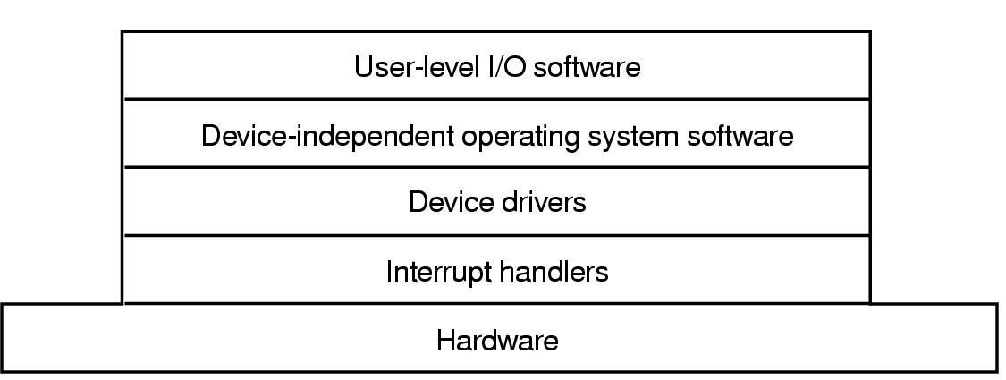
I/O software layers

Slide 21
I/O software layers

Slide 22
Interrupt handling
I/O Device Driver starts the operation
  Then blocks until an interrupt occurs
  Then it wakes up, finishes, & returns
The Interrupt Handler
  Does whatever is immediately necessary
  Then unblocks the driver
Example: The BLITZ “DiskDriver”
  Start I/O and block (waits on semaphore)
  Interrupt routine signals the semaphore & returns

Slide 23
Interrupt handlers – top/bottom halves
Interrupt handlers are divided into scheduled and non scheduled tasks
Non-scheduled tasks execute immediately on interrupt and run in the context of the interrupted thread
  Ie. There is no VM context switch
  They should do a minimum amount of work so as not to disrupt progress of interrupted thread
  They should minimize time during which interrupts are disabled
Scheduled tasks are queued for processing by a designated thread
  This thread will be scheduled to run later
  May be scheduled preemptively or nonpreemptively

Slide 24
Basic activities of an interrupt handler
  Set up stack for interrupt service procedure
  Ack interrupt controller, reenable interrupts
  Copy registers from where saved
  Run service procedure

Slide 25
I/O software layers

Slide 26
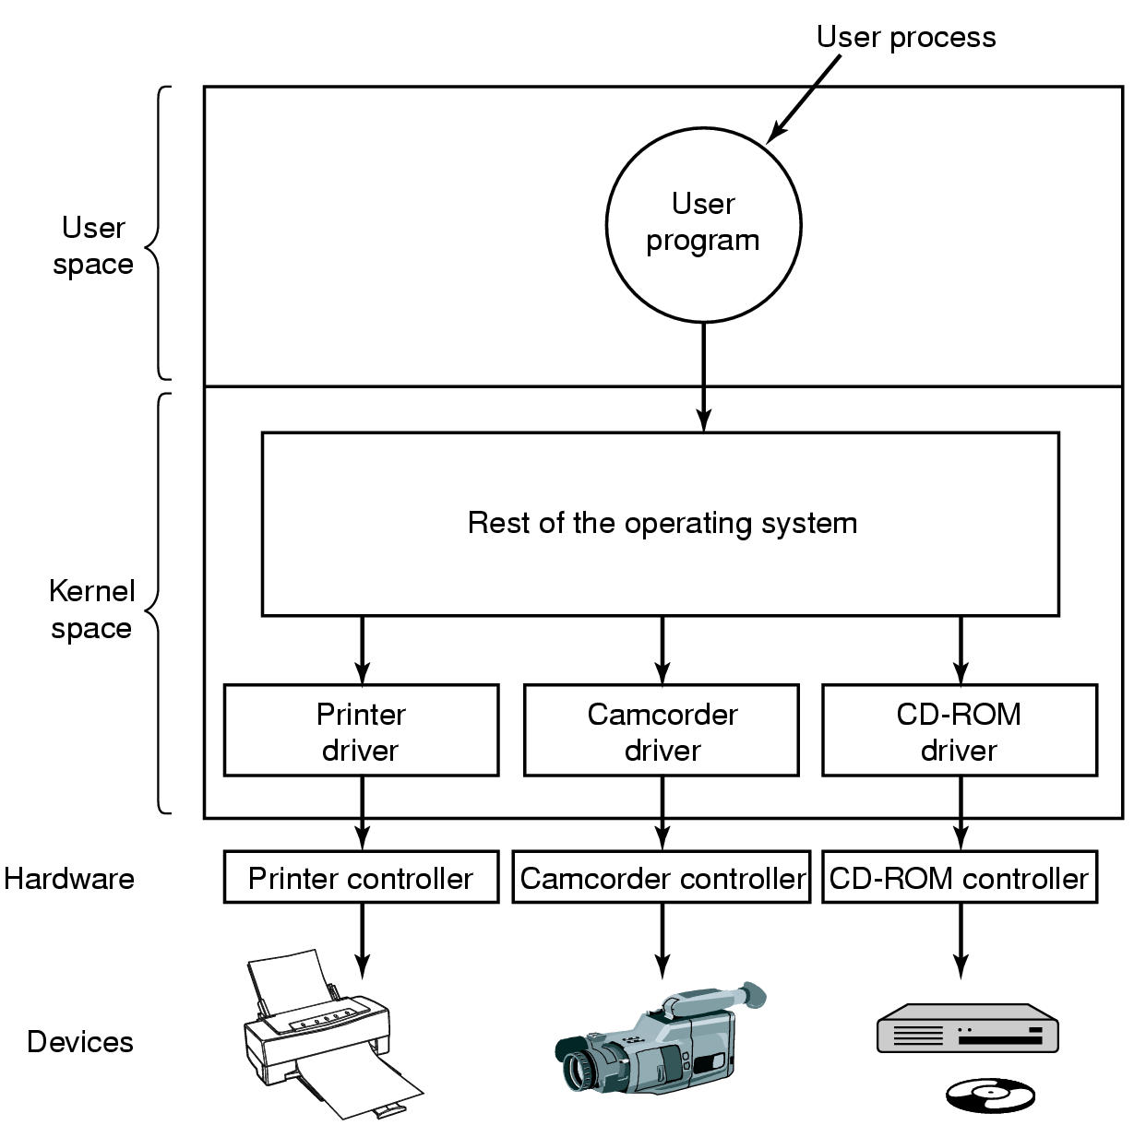
Device drivers in kernel space

Slide 27
Device drivers
Device drivers are device-specific software that connects devices with the operating system
  Typically a nasty assembly-level job
    Must deal with hardware-specific details (and changes)
    Must deal with O.S. specific details (and changes)
  Goal: hide as many device-specific details as possible from higher level software
Device drivers are typically given kernel privileges for efficiency
  Bugs can bring down the O.S.!
  Open challenge: how to provide efficiency and safety???

Slide 28
I/O software layers

Slide 29
Device-independent I/O software
Functions and responsibilities
  Uniform interfacing for device drivers
  Buffering
  Error reporting
  Allocating and releasing dedicated devices
  Providing a device-independent block size

Slide 30
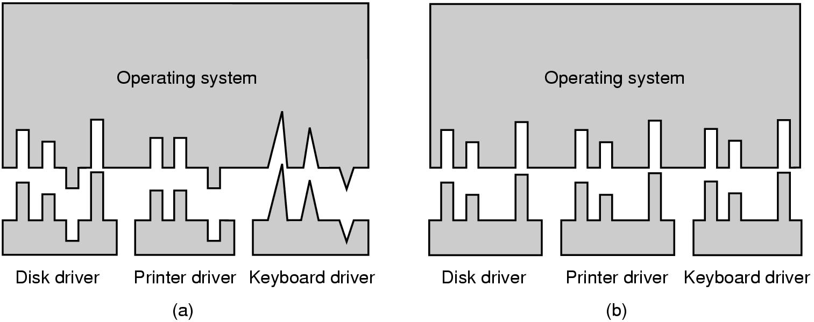
Device-independent I/O software
Device Driver Interface (DDI) and Device Kernel Interface (DKI)
without/with standardization

Slide 31
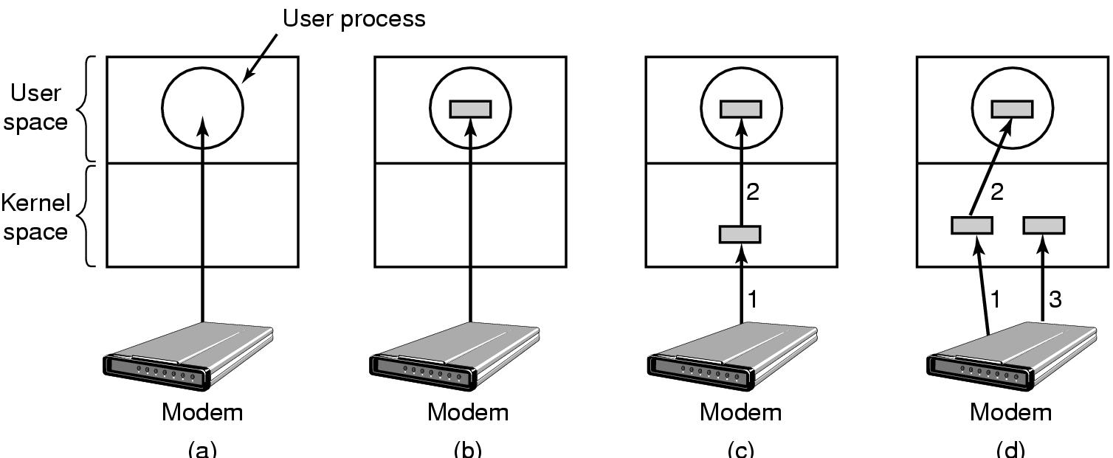
Device-independent I/O software buffering
(a) Unbuffered input
(b) Buffering in user space
(c) Buffering in the kernel followed by copying to user space
(d) Double buffering in the kernel

Slide 32
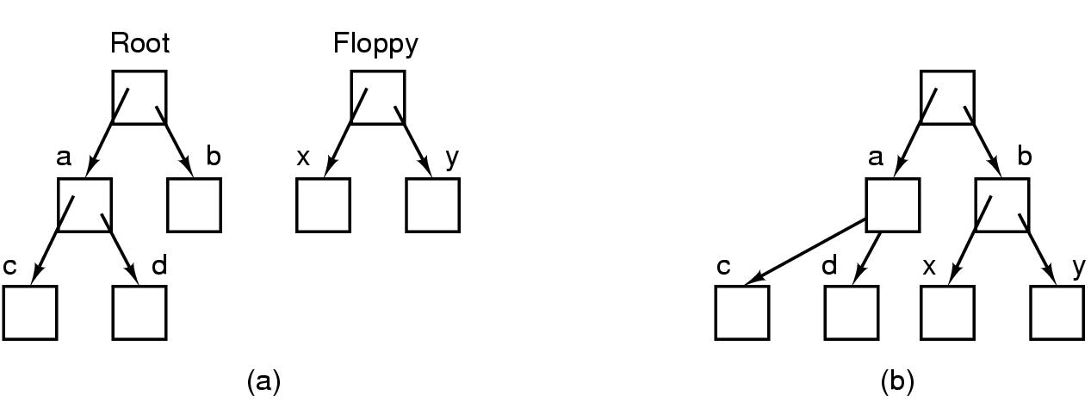
Devices as files
Before mounting,
  files on floppy are inaccessible
After mounting floppy on b,
  files on floppy are part of file hierarchy

Slide 33
I/O software layers

Slide 34
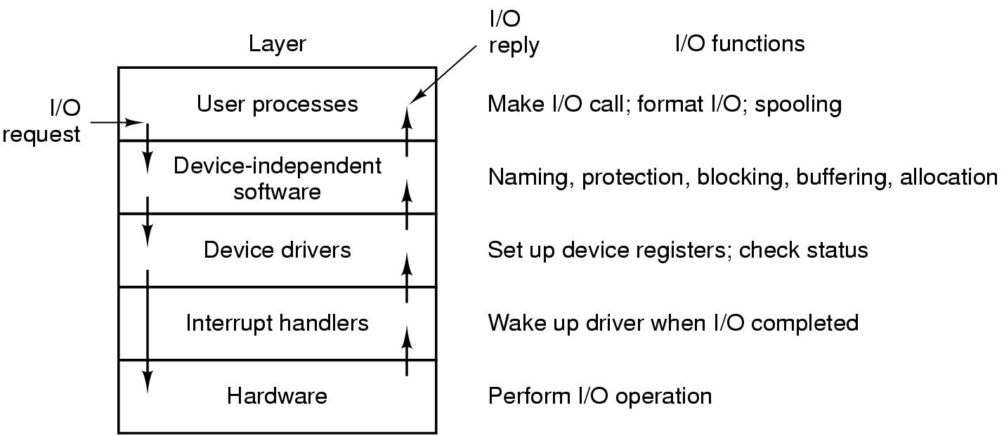
Communicating across the I/O layers

